Slide 1
Entity framework mapping
Entity framework mapping
OLEG LUCASH

Slide 2
Contents
Modeling the database
What is a mapping?
Configuring non relational property
Default naming convention
Data annotations
Fluent api

Slide 3
Modeling the database

Slide 4
Modeling the database
Before I can do anything with the database, EF must go through a process that I refer to as modeling the database. This modelling is EF way of working out what the database looks like by looking at the classes and other EF configuration data. The resulting model is then used by EF in all database accesses.
The modeling process is kicked off the first time you create the application’s DbContext

Slide 5
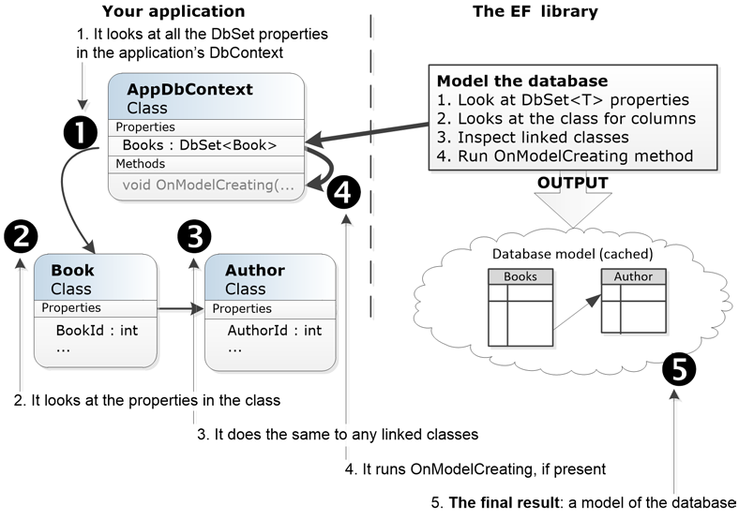
How EF models the database

Slide 6
How EF models the database
EF looks at the application’s DbContext and finds all the public DbSet<T> properties. From this it defines the initial name for the one table it finds, Books.
It then looks through all the classes referred to in the DbSet<T> and looks at its properties to work out the column names, type etc. It also looks for special attributes on the class and/or properties which provide extra modeling information
It also looks for any classes that the DbSet<T> classes refer to 3. In our case the Book class has a reference to the Author class, so it scans that too. It carries out the same search on the properties on the Author class as it did on the Book class in step 2. It also takes the class name, Author, at the table name.

Slide 7
How EF models the database
For the last input to the modeling process it runs the virtual method OnModelCreating inside the application’s DbContext.
Finally, it creates an internal model of the database based on all the information it gathered. This database model is cached so that later accesses will be quicker. This model is then used when performing all database accesses.

Slide 8
EF Mapping

Slide 9
Setting up the application
There are two fundamental parts I need to write before I can create any database access code. These are:
Create the classes that I want EF to map to the tables in my database.
Create what is referred to as the application’s DbContext. This is the primary class that I will use to configure and access the database.

Slide 10
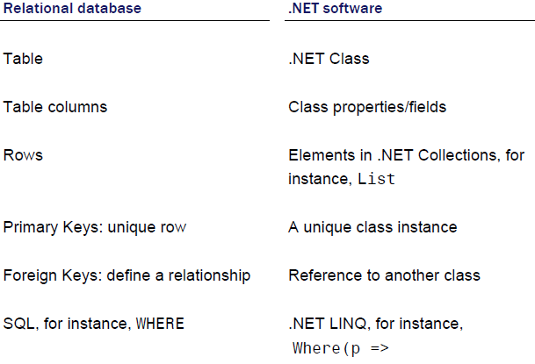
What is a mapping in ef?
EF can be used as an Object Relational Mapper, shorted to O/RM, which maps between the relational database and the .NET world of classes and software code.

Slide 11
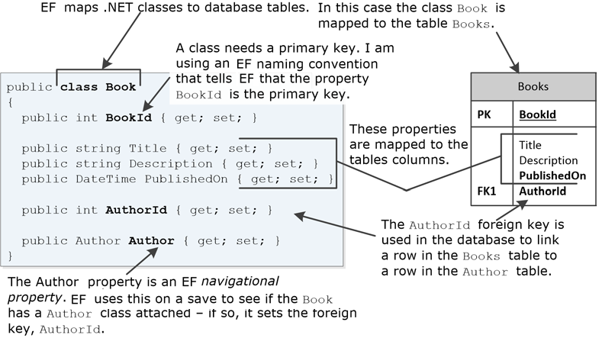
Mapping example
EF maps classes to database tables. Therefore, you need to create a class that will define the database table, or matches a database table if you already have a database.

Slide 12
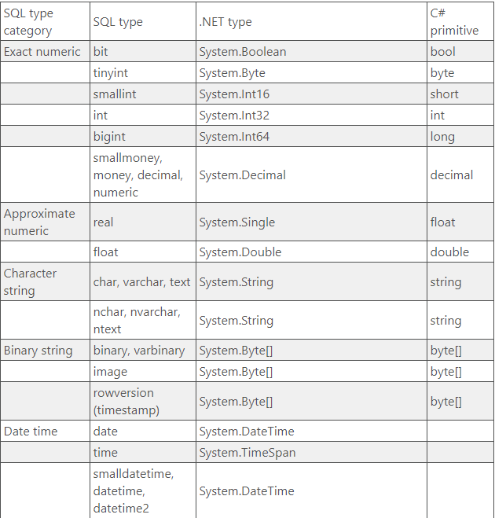
Data Types
Entity Framework can map most SQL data types to .NET types:

Slide 13
Configuring non relational property

Slide 14
Configuring non relational property
There are three different approaches that are available to configure mapping on EF entities:
By convention: When you follow some simple rules on property types and names, EF will auto-configure many of the software and database features. Using the by convention approach is quick and easy, but it can’t handle every eventuality.
Using Data Annotations: There are a range of .NET Attributes, known as Data Annotations, that you can add to entity class and/or properties to provide extra configuration information. These can also be useful for data validation.
By Fluent API. EF has a method called OnModelCreating that is run when the EF Context is first used. You can override this method and add commands, known as Fluent API, to provide extra information to EF in its modeling stage. Fluent API is the most comprehensive form of configuration information, with some features only available via Fluent API.

Slide 15
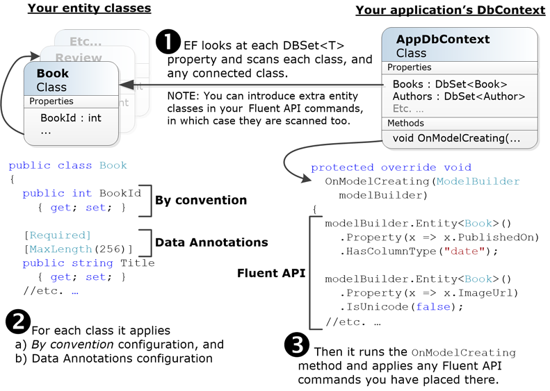
Conventions

Slide 16
Configuring by conventions
Classes that EF maps to the database are called entity classes. Usually they are POCO classes
The by convention configurations is the default configuration and can be overridden by the other two approaches, Data Annotations and Fluent API.
The by configuration approach relies of the developer using the by configuration naming conventions and type mappings, which then allow EF to find and configure entity classes and their relationships as well as define much of the database model.

Slide 17
Convention for entity classes
The class must be of public access, that is, the keyword public should be before the class.
The class cannot be static class, as it must be able to create a new instance of the class.
• The class should have no constructor, or add a public, parameter-less constructor. This means that the class can be created without any parameters being required.

Slide 18
Conventions for parameters in an entity class
By convention EF will look for properties in an entity class that have a public access, a public getter, and a setter of any access mode, that is, public, internal, protected or private. The typical, all-public, property is show in the following snippet:
public int MyProp { get; set; }
public int MyProp { get; private set; }

Slide 19
Name, type, and size conventions
The rules for name, type and size of a relational column are that:
The name of the property is used as the name of the column in the table.
The .NET Type is translated by the database provider to the corresponding SQL Type. Many basic .NET Types have a one-to-one mapping to a corresponding database type. These basic .NET types are mostly what are known as .NET primitive types, like int, bool, and so on, with some special cases like string, DateTime, Guid.

Slide 20
By convention “the Nullability”
Whether a column can be NULL or not is defined by the .NET Type:
• If it is a string, then, because a string can be null, the column can be NULL.
• Primitive types (for instance, int), or struct types (for instance, DateTime), are, by default, non-null.
• Primitive or struct types can be made nullable either using the ? suffix (for instance, int?), or via the generic Nullable<T> (for instance, Nullable<int>). In these cases, the column can be NULL.

Slide 21
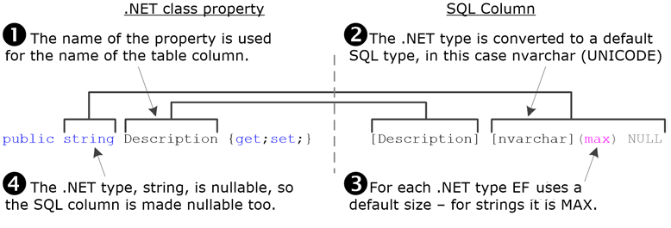
By convention Example

Slide 22
An EF naming convention identifies primary keys
The other rule is about defined database table’s primary key. The EF conventions for designating a primary key are:
1. EF expects one primary key property (the by convention approach does not handle keys made up of multiple properties/columns, called a composite key).
2. The property is called Id or ‘<class name>id’, for instance, BookId.
3. The type of the property defines who assigns a unique value to the key. There are three options:
a. The database assigns the value: for instance, if the .NET type is int.
b. EF assigns the value: for instance, if the .NET type is GUID.
c. Your code assigns the key: for instance, if the .NET type is string.

Slide 23
An EF naming convention identifies primary keys
The name of the property tells EF that this property is the primary key. Also, the database provider knows that a type of int means it should create a unique value for each row added to the table.

Slide 24
Configuring via Data Annotation
Data Annotations are a specific type of .NET attribute that are used for validation and database features. The attributes can be applied to an entity class or property and provide configuration information to EF.
The attributes that are relevant to EF configuration are called Data Annotations and come from two namespaces:
System.ComponentModel.DataAnnotations
System.ComponentModel.DataAnnotations.Schema

Slide 25
System.ComponentModel.DataAnnotations
The attributes in the System.ComponentModel.DataAnnotations namespace are mainly used for data validation at the front-end such as ASP.NET, but EF uses some of them for creating the mapping model. Attributes like [Required] and [MaxLength] are the main ones, with many of the other Data Annotations having no effect on EF.

Slide 26
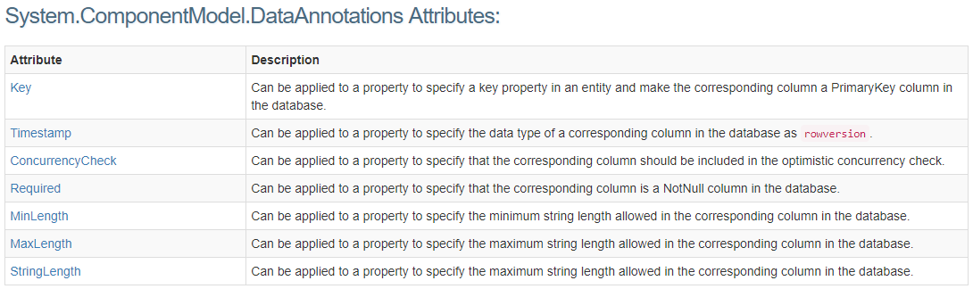
System.ComponentModel.DataAnnotations

Slide 27



System.ComponentModel.DataAnnotations.Schema
The attributes in this namespace are more specific to database configuration, with attributes such as [Table], [Column] and so on, which that set the table name and column name/type
Setting the table name to XXX for mapped to the class Book:
Setting the schema name on a specific table:
Setting the column name of property BookId to SpecialCol

Slide 28
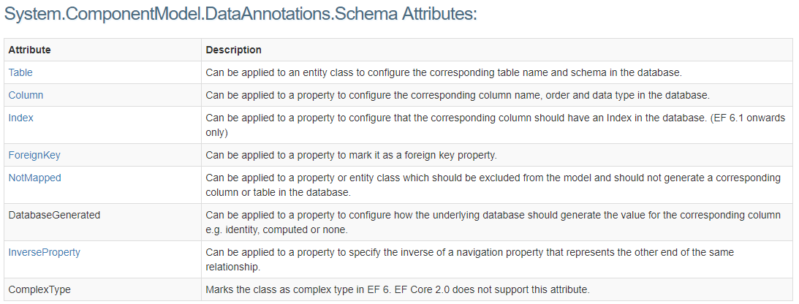
System.ComponentModel.DataAnnotations.Schema

Slide 29
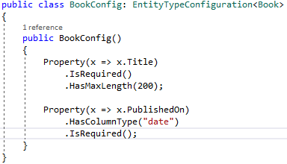
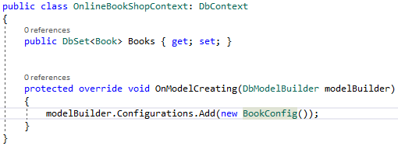
Configuring via Fluent API
Fluent API approach is a set of methods that work on the ModelBuilder class that is available in the OnModelCreating method inside your application’s DbContext. The Fluent API provides the most comprehensive list of configuration commands, with many configurations only available via the Fluent API.
Best way to structure your Fluent API commands:

Slide 30
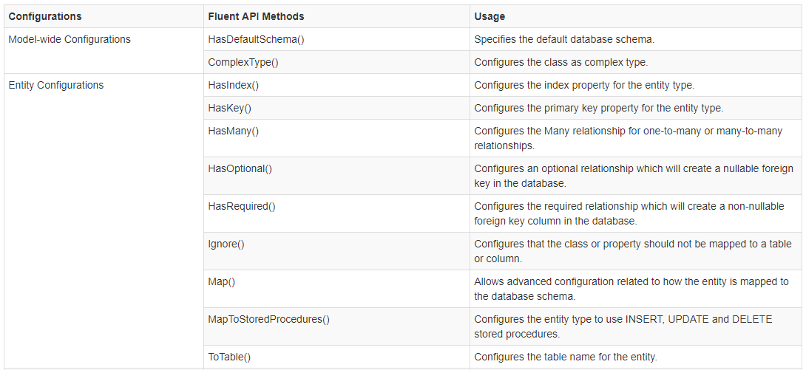
Configuring via Fluent API

Slide 31
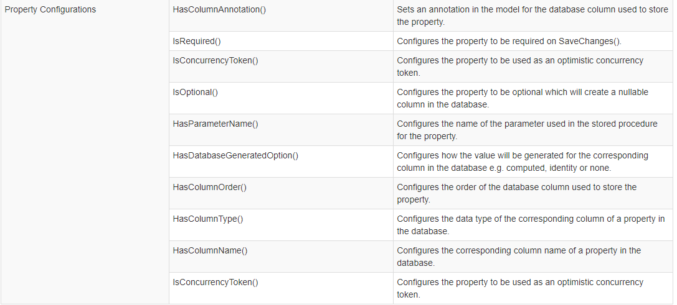
Configuring via Fluent API

Slide 32
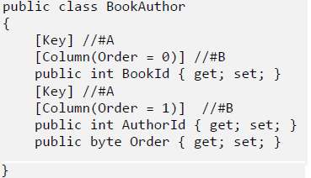
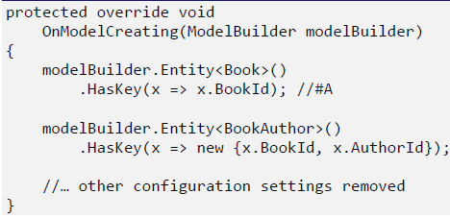
Configuring a primary key via Data Annotations AND Fluent API
There are two situations where you need to explicitly configure the primary key:
When the key name does not fit the by convention naming scheme.
• When the primary key is made up of more than one property/column – called a composite key.
Using Data Annotations: Using Fluent API:

Slide 33
Using ef configurations
The first time you create the application’s DbContext, EF configures itself using a combination of three approaches: by convention, Data Attributes and Fluent API.
What happens if a Data Annotation and Fluent API say different things? The Data Annotation and the Fluent API modeling methods always override the convention-based modeling. But what happens if a Data Annotation and a Fluent API both provide a mapping of the same property and setting? The answer is: Fluent API is the final arbitrator.
Here are some suggestions on which of the approaches to use for each part of the configuration of EF. In summary:
1. Start by using the by convention approach wherever possible, as they are quick and easy.
2. For everything else then use the Fluent API approach, because it has the most comprehensive set of commands.

Slide 34
Assignment
Study different approaches that are available to configure mapping in ef.
Map your NH Domain Model to Previously Created Database using convention and fluent api approach.
Pay attention to Not nullable, column Types, nvarchar lengths
Create generic repository with Create, Update, deletes operations

Slide 35
References
https://weblogs.asp.net/dixin/entity-framework-core-and-linq-to-entities-2-modeling-database-object-relational-mapping
http://www.entityframeworktutorial.net/code-first/fluent-api-in-code-first.aspx

Slide 36
Revisions
Number | Author | Date | Description
1.0.0 | Oleg Lucash | 03.03.2018 | Initial version

